Slide 1







GLOBAL NEEDS · ACADEMIC PRESENTATION
COLLEGE PRESENTATION
Global Needs:
Deforestation
Understanding the problem, its human impact, and practical ways forward
PRESENTED BY T. PUJITHA, T. MRUDHULA, N. RUSHIKA, S. JAHNAVI
A PROBLEM THAT CONNECTS CLIMATE, BIODIVERSITY,
GUIDE: R. RAJALAKSHMI
LIVELIHOODS, AND GOVERNANCE.

Slide 2

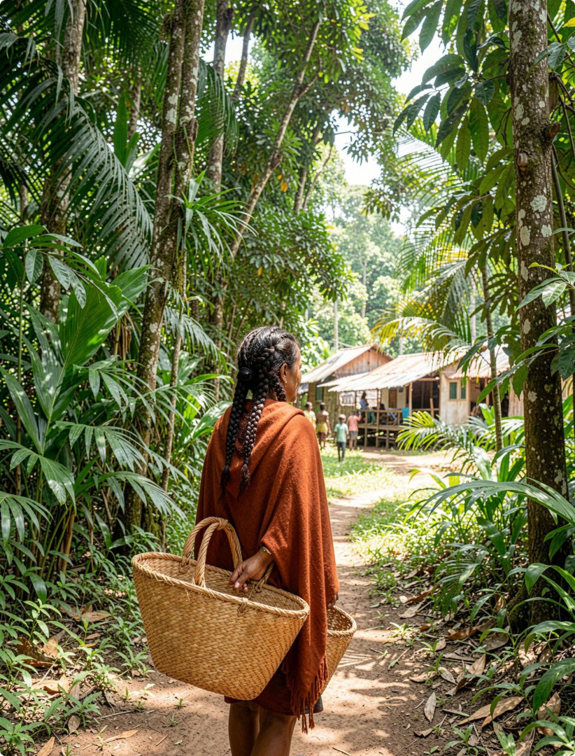




01 / WHY IT MATTERS
Deforestation is a global problem with
local consequences
Deforestation removes natural protection against heat, floods, soil erosion, and
biodiversity loss. One land-use decision can affect climate, wildlife, and communities at
the same time.
GLOBAL SCALE
LOCAL PRESSURE
4.06B
Forest-dependent people face
pressure on food, fuel, water, health,
About 4.06 billion hectares of forest
and livelihoods.
cover nearly one-third of the world’s
land area.
SOURCE: FAO
Key question: how can development meet human needs without destroying the systems
that support life?

Slide 3










02 / INTRODUCTION
Introduction: what deforestation changes
Forests are living infrastructure, not empty land.
Land use
Drivers
Ecology
People
Deforestation is the permanent
Agricultural expansion, cattle
Forest loss breaks habitats into
Some forest products are essential
removal of trees and forest cover
grazing, logging, mining, roads,
smaller areas, weakens ecosystem
to households, so solutions must
to convert land for other uses.
fires, and settlement growth.
services, and can increase
protect both nature and people’s
exposure to extreme weather.
needs.
THE SYSTEM
Climate · water · soil · biodiversity · communities are connected through the forest.

Slide 4
















03 / SURVEY + EVIDENCE
Survey and 2020 evidence: the pressure is measurable
The rate of net loss slowed, but forest area continued to decline.
GLOBAL FOREST AREA TREND, 1990–2020
Estimated net forest loss (million ha…
7.8
5.2
8
WHAT THE ASSESSMENT COVERED
236 countries and territories
6
FAO examined more than 60 forest variables across 1990–
2020.
4
4.7
TOTAL CHANGE
2
178M hectares
Global forest area declined by about 178 million hectares
0
between 1990 and 2020, roughly the size of Libya.
1990–2000
2000–2010
2010–2020
SOURCE: FAO
Period
SOURCE: FAO GLOBAL FOREST RESOURCES ASSESSMENT 2020
LOCAL SURVEY QUESTIONS
Where do households get fuel and timber? Have rainfall, heat, or water availability changed? Which forest rules
are difficult to follow?

Slide 5






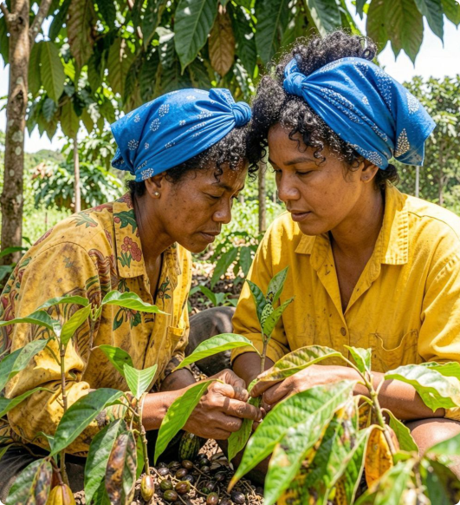
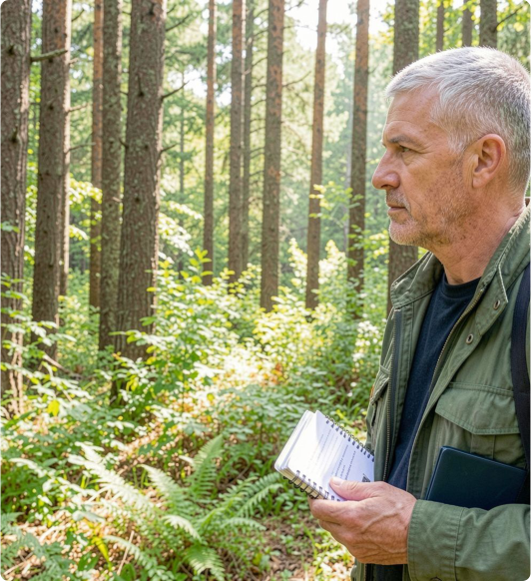
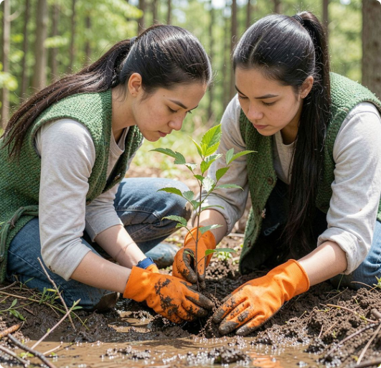
04 / PRACTICAL RESPONSES
Solutions should protect forests and people together
Protection lasts when it supports food, energy, rights, and livelihoods.
RESTORATION + ENERGY
Restore native ecosystems with local species;
AGROFORESTRY
LOCAL RIGHTS
measure survival, water, soil, and livelihood
Support agroforestry and climate-smart farming
Strengthen community forest management,
outcomes. Reduce household pressure through
so food production does not depend on clearing
secure local rights, and reward verified
efficient cooking, clean energy, and affordable
new forest.
protection.
alternatives to illegal fuelwood.
TRACE TIMBER, PALM OIL, SOY, CATTLE, AND OTHER HIGH-RISK SUPPLY CHAINS; MEASURE SURVIVAL, WATER, SOIL, AND LIVELIHOOD OUTCOMES.

Slide 6








05 / EXISTING SYSTEMS
Existing systems: useful tools, incomplete protection
The gap is not a lack of tools. It is the missing connection between detection, action, and benefit.
CURRENT PROTECTION LOOP
INCOMPLETE PROTECTION
Boundaries cannot stop pressure outside
Protected areas
Monitoring
protected areas.
Conserve important habitats.
Detect and compare forest
Detection does not automatically trigger a
change.
response.
Enforcement and transparent data remain
uneven.
Local action
Accountability
Funding and local participation are often
Communities need voice,
Laws, certification, checks,
short-term.
reliable livelihoods, and long-
and restoration create
Assessment: connect monitoring to rapid action
term support.
standards.
and community benefit, rather than treating them
as separate projects.

Slide 7


06 / PROPOSED SOLUTION
Proposed solution: a community-led forest protection loop
Use evidence to act early, then let local results improve the next decision.
01
02
03
04
05
Map risk
Co-design
Act early
Measure
Review
Combine satellite data with
Plan protection and
Use patrols, fire prevention,
Publish forest cover,
Assess results every season
local knowledge.
livelihoods with
restoration, and sustainable
biodiversity, water, income,
and redirect resources to
communities, farmers, and
production support.
and participation measures.
what works.
local government.
CONCLUSION
Evidence + local ownership + responsible consumption + restoration + accountable governance.

Slide 8
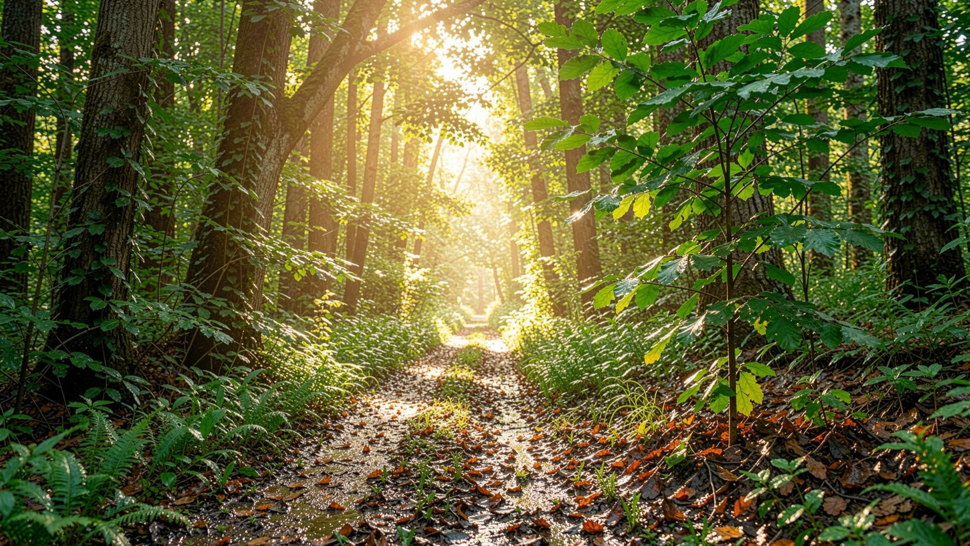


GLOBAL NEEDS · DISCUSSION
Thank you
Protect forests.
Protect people.
Protect the future.
Questions and discussion
R. RAJALAKSHMI

